Slide 1
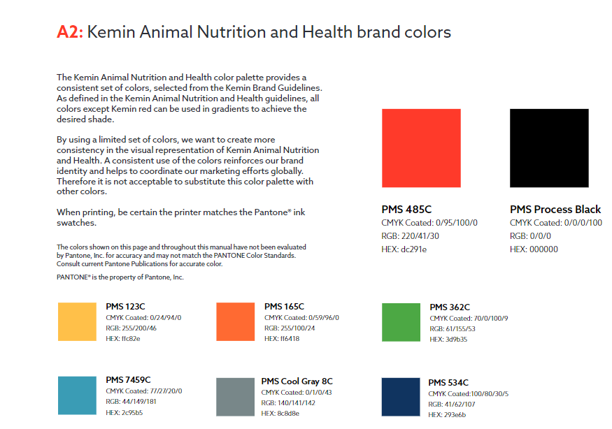
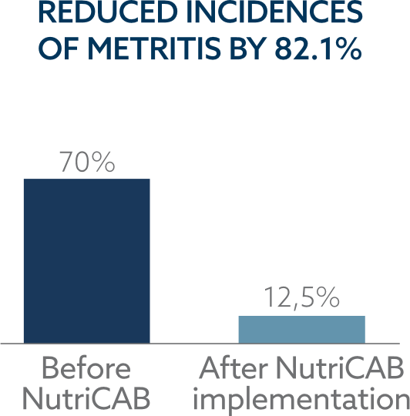
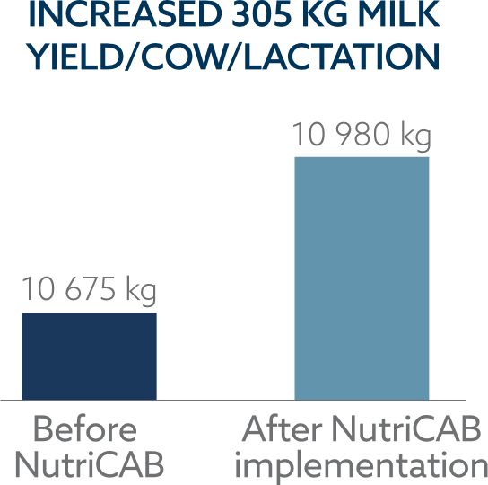
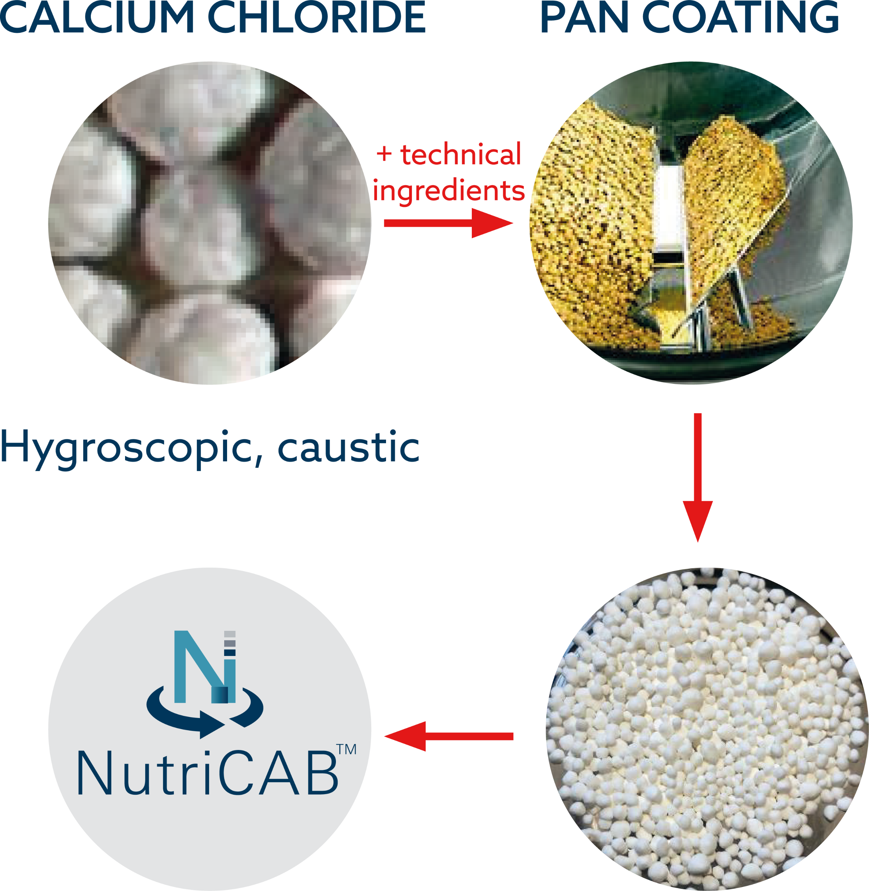
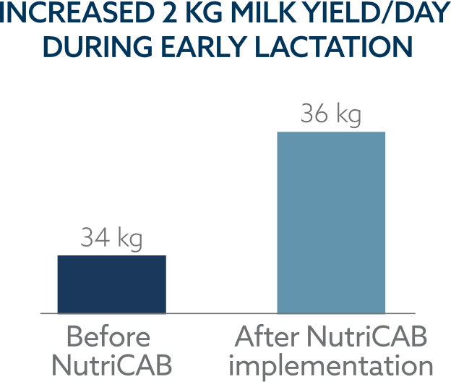
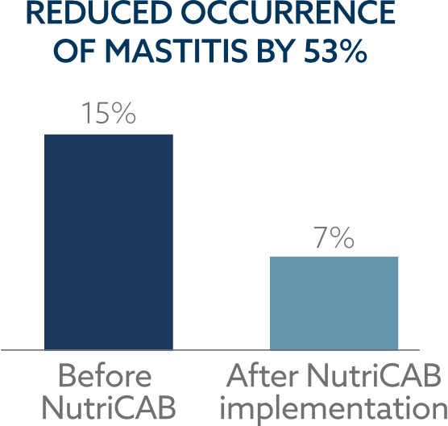
Subclinical hypocalcemia: Field experience of cause and control Dubey Deepak Kumar, Pauwelyn Bram and Mateos Javier Kemin Europa NV Toekomstlaan 42, 2200 Herentals (Belgium)
Introduction
Subclinical metabolic diseases, such as subclinical hypocalcemia (SCH), are of current concern because they are linked to an increased risk of periparturient issues.
Subclinical hypocalcemia is common in Europe, according to a new study from Germany (Venjakob et al., 2017). Subclinical hypocalcemia and clinical milk fever were seen in 47.6% and 8.6% of multiparous cows, respectively.
Objective
According to a meta-analysis that included 42 randomized trials (Santosh et al., 2019), cows fed cationic diets are more likely to develop milk fever or hypocalcemia.
The purpose was to see if the European diets were associated to the prevalence of subclinical hypocalcemia.
Material & Methods
Various diets were studied to determine the status of dietary cation anion balance (DCAB).
Also, diets were made acidogenic with the help of NutriCABTM which is a source of coated form of calcium chloride to mask the bitterness of anionic salt during intake, controlling hygroscopicity during application & storage, and ensuring skin safety.
Result and conclusion
The majority of diets in the EMENA region are cationic in nature, as the components used in the diet are mostly cationic.
When diets were made acidogenic with palatable NutriCABTM under Kemin's formulating ruminant health program for pre-calving cows, field experience from different farms clearly showed that the incidence of retained foetal membranes was reduced by 81 percent, metritis was reduced by 82.1 percent and mastitis was reduced by 53 percent.
The reduction of subclinical metabolic disorders improves peak milk production and lactation persistence.
When pre-calving diets were turned acidogenic with NutriCAB, there was a 5.9% increase in peak milk production.
Ingredients | Dry matter, % | As fed, kg | Dry matter intake, kg
Soybean hulls ground | 90.2 | 0.200 | 0.180
Corn grain 73 % starch | 87.5 | 0.300 | 0.263
Canola meal solv. extr. | 91.9 | 0.850 | 0.781
Soybean meal solv. 47% | 90.0 | 0.925 | 0.833
Soft wheat shorts 39% | 88.0 | 0.187 | 0.165
Urea | 99.0 | 0.015 | 0.015
Sugarcane molasses 49% | 73.3 | 0.060 | 0.044
Min + Vit Dry Cow | 93.6 | 0.042 | 0.039
Sodium Chloride | 99.8 | 0.006 | 0.006
Calcium carbonate | 99.2 | 0.005 | 0.005
Ryegrass silage | 31.9 | 13.500 | 4.307
Corn Silage | 34.1 | 5.000 | 1.705
Barley Straw | 87.8 | 5.500 | 4.829
Total |  |  | 13.171
DCAD Status: +179 mEq/kg dietary dry matter
Table 1: DCAB status of a common pre-calving cow’s diet in Europe checked through AMTS dietary software
Graph 1: Cow performance before and after NutriCAB implementation
Graph 2: NutriCAB: Technology of encapsulation
Summary
In dairy herds, subclinical hypocalcemia is common and should not be overlooked. According to studies, pre-calving cow diets should be acidogenic to counteract hypocalcemia. Acidogenic diets not only minimize subclinical metabolic problems but also increase lactation performance.
References
Santos, J.E.P., I.J. Lean, H. Golder, and E. Block. 2019. Meta-analysis of the effects of prepartum dietary cation-anion difference on performance and health of dairy cows. J. Dairy Sci. 102: 2134-2154
Venjakob, P.L., S. Borchardt, and W Heuwieser. 2017. Hypocalcemia – Cow- level prevalence and preventive strategies in German dairy herds. J. Dairy Sci. 100 (11): 9258-9266

